Slide 2
Aim
I can recognise and use complex (multi-clause) sentences.
Success Criteria
I can recognise that a complex sentence contains a main (independent) clause and at least one dependent clause.
I can recognise two types of dependent clause: subordinate clauses and relative clauses.
I can use ‘I SAW A WABUB’ to remember some of the main subordinating conjunctions to use in subordinate clauses.
I can use relative pronouns/relative adverbs to create relative clauses.
I can write my own complex sentences.

Slide 3
Getting Started
What is a main clause?
A main clause (or it could be called a simple sentence) is a group of words that expresses one complete thought. Every main clause must contain a subject and a verb. They can also be called independent clauses.
Can you spot the subjects and the verbs in these main/independent clauses?
subject
The horse galloped.
The horse galloped.
The horse galloped.
verb
Mr Richardson ate some cheese.
Mr Richardson ate some cheese.
Mr Richardson ate some cheese.

Slide 4
Getting Started
What is a complex sentence?
A complex sentence is made up of a main clause and then
one or more dependent clauses.
There are two ways of creating dependent clauses:
by using a subordinating conjunction (e.g. after) to create a subordinate clause, e.g.
The horse galloped after it jumped the fence.
by adding extra information using a relative clause.
Mr Richardson, who was feeling ravenous, ate some cheese.

Slide 5
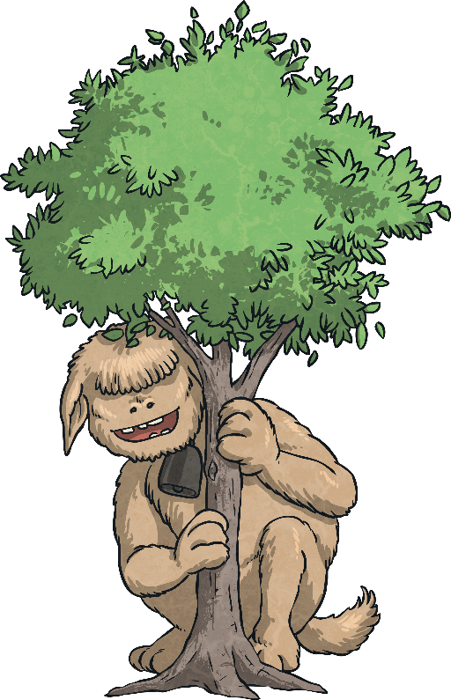
Next Steps: Subordinating Conjunctions
Firstly, let’s look at creating complex sentences by using subordinate clauses that begin with a subordinating conjunction.
I
S
A
W
A
W
A
B
U
B
is an acronym to help you remember the first letters of some of the most important subordinating conjunctions.
If
Since
As
When
Although
While
After
Before
Until
Because

Slide 6

Next Steps: Subordinating Conjunctions
So, how do we use subordinating conjunctions?
Subordinating conjunctions are the first words within a subordinate clause. Subordinate clauses do not make sense on their own (they are dependent) but when they are used with a main clause, they create a complex (multi-clause) sentence.
Subordinate clauses will always have a subject and verb within them, e.g.
before they left
before the holidays
verb
subordinating conjunction
subject
here ‘before’ is being used as a preposition
is a subordinate clause
is not a subordinate clause
I SAW A WABUB!

Slide 7
Next Steps: Subordinating Conjunctions
Can you spot the subordinate clause and the subordinating conjunction in this complex sentence?
Juvenile penguins are able to swim, although their feathers aren’t yet waterproof.
Juvenile penguins are able to swim, although their feathers aren’t yet waterproof.
I SAW A WABUB!

Slide 8
Next Steps: Subordinating Conjunctions
Can you spot the subordinate clause and the subordinating conjunction in this complex sentence?
The boy scouts sang around
the campfire until it was time
for bed.
The boy scouts sang around
the campfire until it was time
for bed.
I SAW A WABUB!

Slide 9
Next Steps: Subordinating Conjunctions
Can you spot the subordinate clause and the subordinating conjunction in this complex sentence?
Hakim could win the talent contest if he improved his juggling skills.
Hakim could win the talent contest if he improved his juggling skills.
I SAW A WABUB!

Slide 10
Next Steps: Subordinating Conjunctions
In the complex sentences we have looked at so far, the subordinate clause has always come after the main clause but watch…
Juvenile penguins are able to swim although their feathers aren’t yet waterproof.
Although their feathers aren’t yet waterproof, juvenile penguins are able to swim.
I SAW A WABUB!

Slide 11
Next Steps: Subordinating Conjunctions
Although their feathers aren’t yet waterproof, juvenile penguins are able to swim.
Subordinating conjunctions can also be used as the first word in a complex sentence. When the subordinate clause comes before the main clause, make sure you remember to use a comma to mark where the subordinate clause ends.
I SAW A WABUB!

Slide 12
Next Steps: Subordinating Conjunctions
Can you swap these sentences around so that the subordinate clause comes before the main clause? Don’t forget your commas!
The boy scouts sang around the campfire until it was time for bed.
Until it was time for bed, the boy scouts sang around the campfire.
Hakim could win the talent contest
if he improved his juggling skills.
If he improved his juggling skills, Hakim could win the talent contest.
I SAW A WABUB!

Slide 13
Next Steps: Relative Clauses
Now, let’s look at creating complex sentences by using relative clauses. Relative clauses are a different type of dependent clause that give more detail about the subject of the main clause.
Relative clauses begin with a relative pronoun or a relative adverb. Here are some of the most common examples:
who
which
whose
whom
that
where

Slide 14
Next Steps: Relative Clauses
who
which
whose
whom
that
where
Can you spot the relative clause in this complex sentence?
What is the relative clause describing?
Mysterious Malcolm, who is a children’s entertainer, wows his audiences with his magic tricks.
Mysterious Malcolm, who is a children’s entertainer, wows his audiences with his magic tricks.
The relative clause describes the ‘Mysterious Malcolm’ in more detail. When a relative clause is embedded in the middle of a sentence, we surround it with commas.

Slide 15
Next Steps: Relative Clauses
who
which
whose
whom
that
where
Can you spot the relative clause in this complex sentence?
What is the relative clause describing?
The astronaut bounded towards the space buggy, which had been parked in a crater.
The astronaut bounded towards the space buggy, which had been parked in a crater.
The relative clause describes the ‘space buggy’ in more detail.
When a relative clause is dependent on the main clause, we add a comma to demarcate it from the rest of the sentence.

Slide 16
Complex Sentence Hunt
Can you spot the complex sentences in this text?
How have they been created?
The sun was beginning to disappear behind the nearby mountain. Philip’s heart sank as he knew he was lost. The group of climbers, who Philip had started out with, were nowhere to be seen. Philip shouted for help but it was hopeless. While there was still a little light, Philip tried to make himself a bed using leaves and twigs. The temperature, which was now close to zero degrees, could be extremely hazardous. If he couldn’t find a way to keep warm, he would be in serious danger. It was going to be a long night.
The sun was beginning to disappear behind the nearby mountain. Philip’s heart sank as he knew he was lost. The group of climbers, who Philip had started out with, were nowhere to be seen. Philip shouted for help but it was hopeless. While there was still a little light, Philip tried to make himself a bed using leaves and twigs. The temperature, which was now close to zero degrees, could be extremely hazardous. If he couldn’t find a way to keep warm, he would be in serious danger. It was going to be a long night.

Slide 17
Complex Sentence Hunt
Why aren’t these sentences complex?
The sun was beginning to disappear behind the nearby mountain…
This is just a main clause (or you might call it a simple sentence). It is extended by using a prepositional phrase ‘behind the nearby mountain’, but this doesn’t make it a complex sentence.
Philip shouted for help but it was hopeless.
This is a different type of multi-clause sentence: a compound sentence. It has two main clauses that are joined by a co-ordinating conjunction.
It was going to be a long night.
This again is just a main clause (simple sentence). It is still a good idea to include some of these in your writing for effect.

Slide 18
Practise Your Skills
Now, it’s your turn. Could you add a subordinate clause (using an I SAW A WABUB! subordinating conjunction) to this main clause to create a complex sentence:
my little sister is so irritating
Did you place your subordinate clause before or after the main clause? Did you include the correct punctuation?
I SAW A WABUB!

Slide 19
Practise Your Skills
Now, it’s your turn. Could you add a subordinate clause (using an I SAW A WABUB! subordinating conjunction) to this main clause to create a complex sentence:
the dolphin jumped up from
the water
Did you place your subordinate clause before or after the main clause? Did you include the correct punctuation?
I SAW A WABUB!

Slide 20
Practise Your Skills
Now, it’s your turn. Could you add a relative clause (using a relative pronoun or relative adverb) to this main clause to create a complex sentence:
Tim Peake is a famous
British astronaut
Did you place you embed your relative clause within the
main clause or did you add the relative clause after it?
Did you include the correct punctuation?
who
which
whose
whom
that
where

Slide 21
Practise Your Skills
Now, it’s your turn. Could you add a relative clause (using a relative pronoun or relative adverb) to this main clause to create a complex sentence:
The house on the hill
remained unsold
Did you place you embed your relative clause within the
main clause or did you add the relative clause after it?
Did you include the correct punctuation?
who
which
whose
whom
that
where

Slide 22
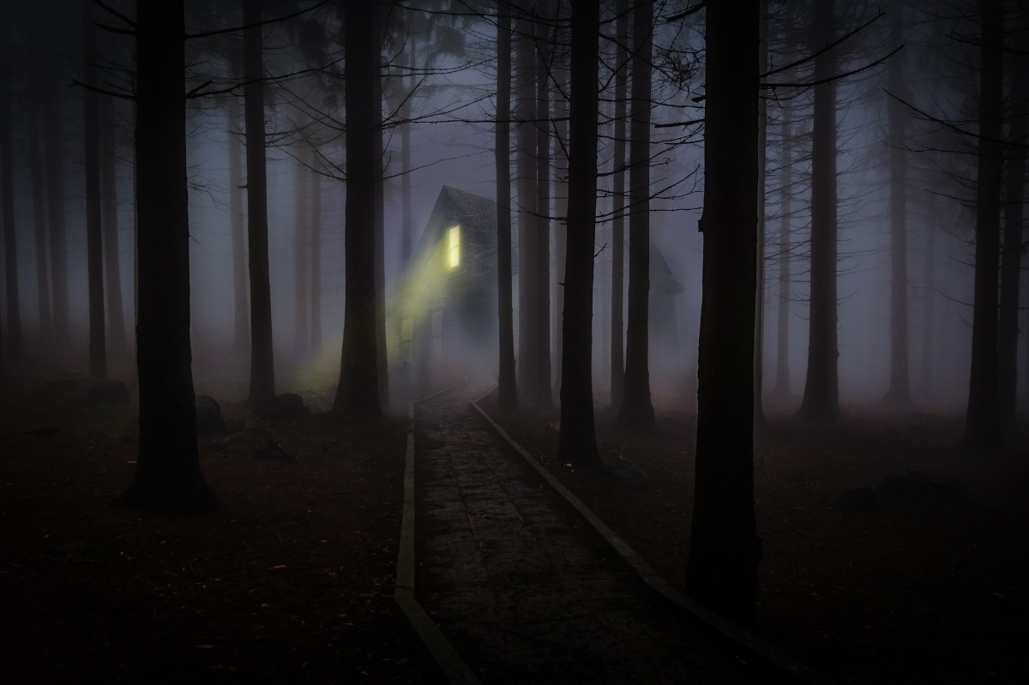
Let’s Write
On the next few slides, we are going to spin the spinner so that we have a particular subordinating conjunction or relative pronoun to use within a complex sentence about a specific picture.
For example, if the spinner landed on ‘as’...
As the children trekked through the misty woods, they saw a light shining from a mysterious building.

Slide 23
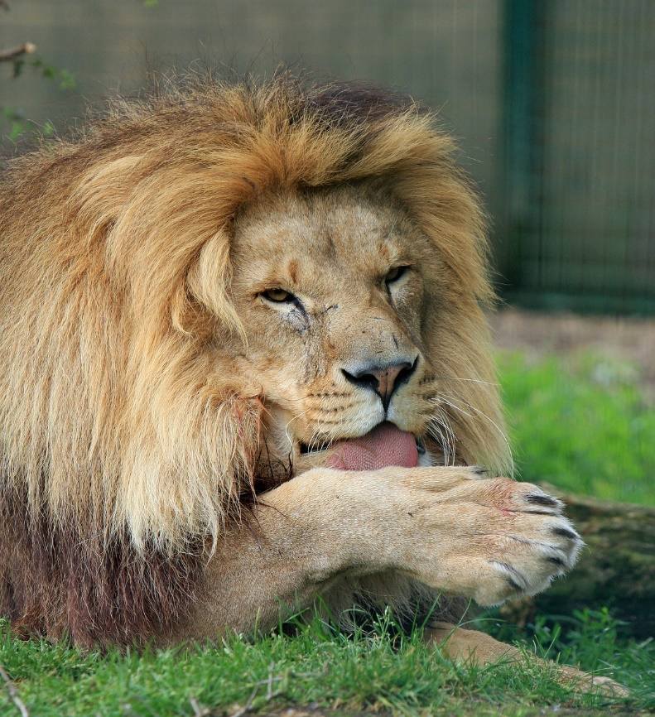
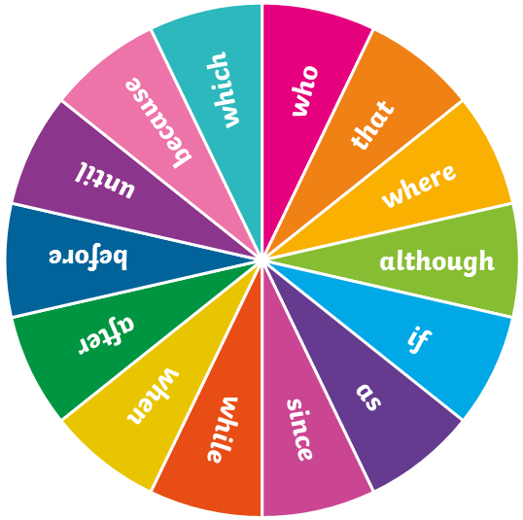
Let’s Write
Can you use a particular subordinating conjunction or relative pronoun to create a complex sentence based on this picture? Spin the spinner to see which word you must use within your complex sentence.
Click here to spin

Slide 24
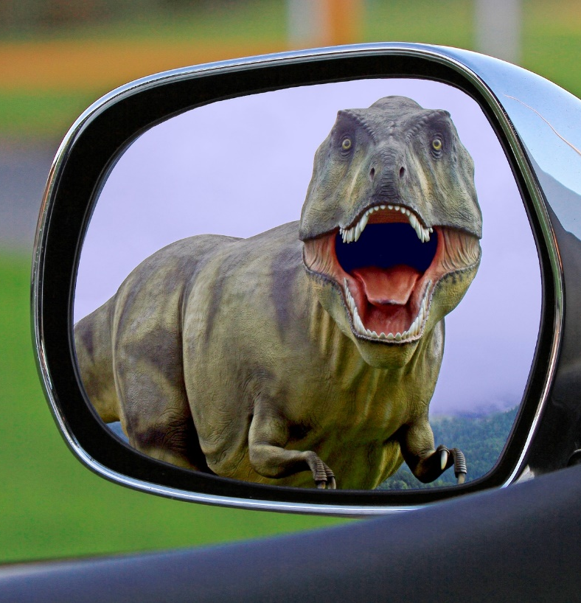
Let’s Write
Can you use a particular subordinating conjunction or relative pronoun to create a complex sentence based on this picture? Spin the spinner to see which word you must use within your complex sentence.
Click here to spin

Slide 25
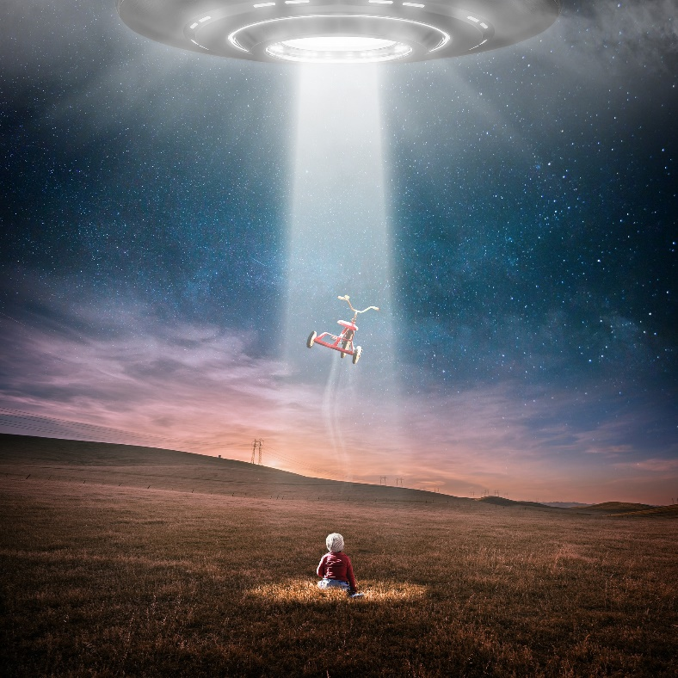
Let’s Write
Can you use a particular subordinating conjunction or relative pronoun to create a complex sentence based on this picture? Spin the spinner to see which word you must use within your complex sentence.
Click here to spin

Slide 26
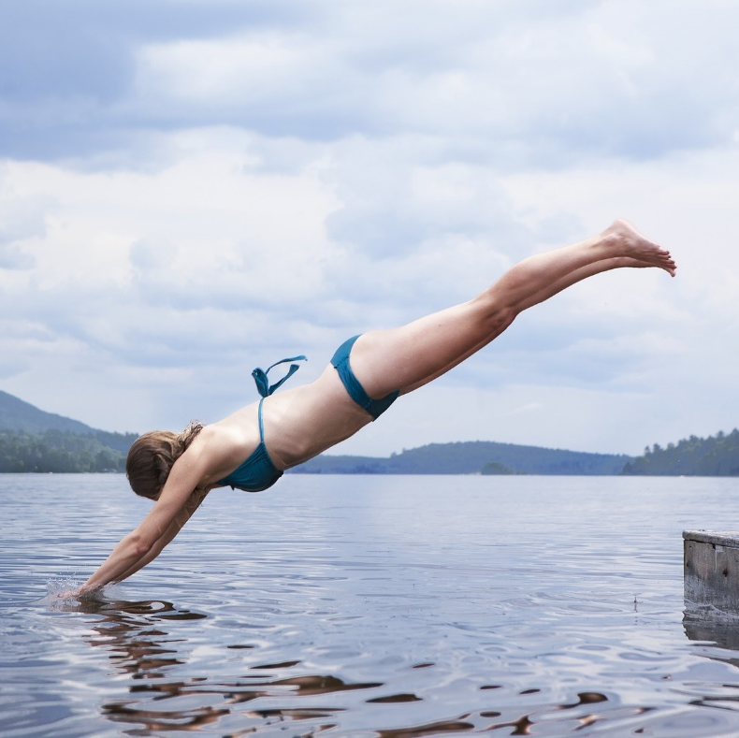
Let’s Write
Can you use a particular subordinating conjunction or relative pronoun to create a complex sentence based on this picture? Spin the spinner to see which word you must use within your complex sentence.
Click here to spin

Slide 27
Quick Quiz: Question 1
Which of these examples are complex sentences?
Can you explain why?
Giraffes have very long necks, which they use to their advantage to reach tall trees.
Giraffes have very long necks, which they use to their advantage to reach tall trees.
The alien approached the spaceship so the crew gasped.
Before lunch, Cassie cycled into town.
Before his Grandma arrived, Billy frantically tidied his bedroom.
Before his Grandma arrived, Billy frantically tidied his bedroom.

Slide 28
Quick Quiz: Question 2
Complete the sentences below by adding your own subordinate clause using your choice of subordinating conjunctions. Your dependent clause can become before or after the main clause.
he had broken the world record
science is an interesting subject

Slide 29
Quick Quiz: Question 3
Can you tell me a relative pronoun or relative adverb that can be used to create a complex sentence with a relative clause?
who
which
whose
whom
that
where
Can you use the word you chose within a complex sentence?

Slide 30
Aim
I can recognise and use complex (multi-clause) sentences.
Success Criteria
I can recognise that a complex sentence contains a main (independent) clause and at least one dependent clause.
I can recognise two types of dependent clause: subordinate clauses and relative clauses.
I can use ‘I SAW A WABUB’ to remember some of the main subordinating conjunctions to use in subordinate clauses.
I can use relative pronouns/relative adverbs to create relative clauses.
I can write my own complex sentences.

